Slide 1
Dynamic Programming

Slide 2
Definition
In mathematics, computer science, and economics, dynamic programming is a method for solving complex problems by breaking them down into simpler sub-problems.
References: http://en.wikipedia.org/wiki/Dynamic_programming

Slide 3
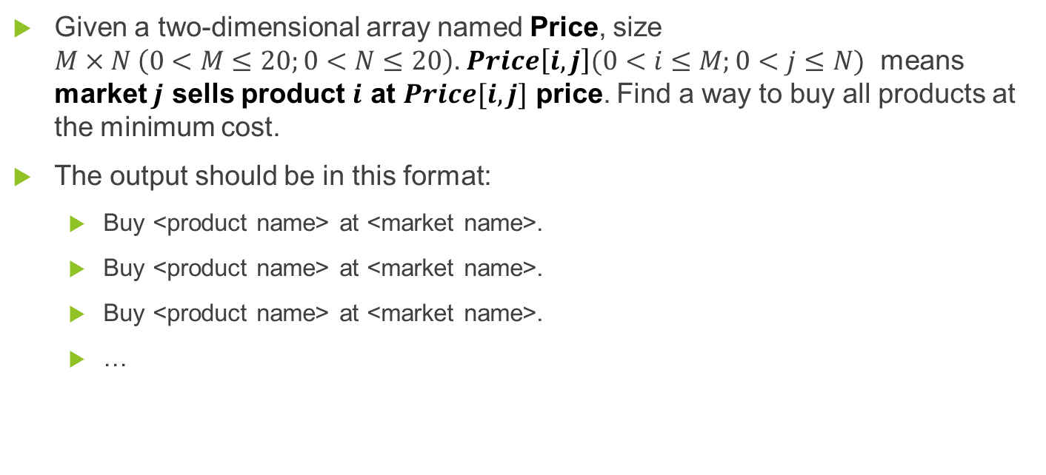
Define Problem
Given a two-dimensional array named Price, size $M×N \left(0<M≤20;0<N≤20\right).$ $Price\left[i,j\right](0<i≤M;0<j≤N)$ means market $j$ sells product $i$ at $Price[i,j]$ price. Find a way to buy all products at the minimum cost.
The output should be in this format:
Buy <product name> at <market name>.
Buy <product name> at <market name>.
Buy <product name> at <market name>.
…

Slide 4
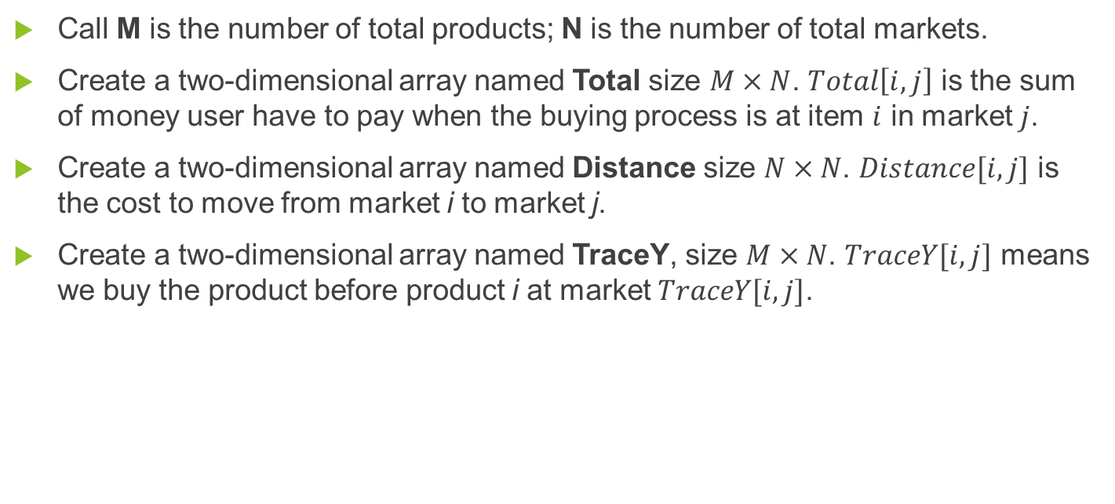
Solution
Call M is the number of total products; N is the number of total markets.
Create a two-dimensional array named Total size $M×N$. $Total\left[i,j\right]$ is the sum of money user have to pay when the buying process is at item $i$ in market $j$.
Create a two-dimensional array named Distance size $N×N$. $Distance[i,j]$ is the cost to move from market i to market j.
Create a two-dimensional array named TraceY, size $M×N$. $TraceY[i,j]$ means we buy the product before product i at market $TraceY[i,j]$.

Slide 5
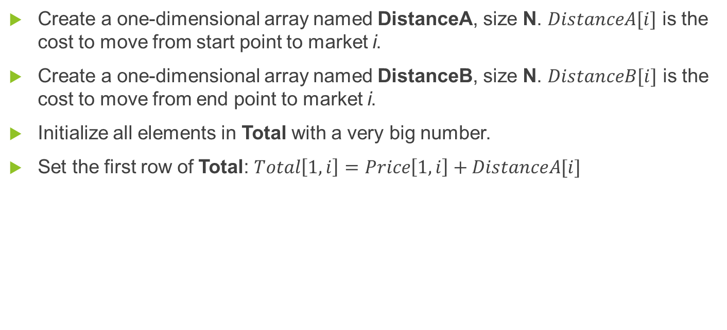
Solution
Create a one-dimensional array named DistanceA, size N. $DistanceA[i]$ is the cost to move from start point to market i.
Create a one-dimensional array named DistanceB, size N. $DistanceB[i]$ is the cost to move from end point to market i.
Initialize all elements in Total with a very big number.
Set the first row of Total: $Total\left[1,i\right]=Price\left[1,i\right]+DistanceA[i]$

Slide 6
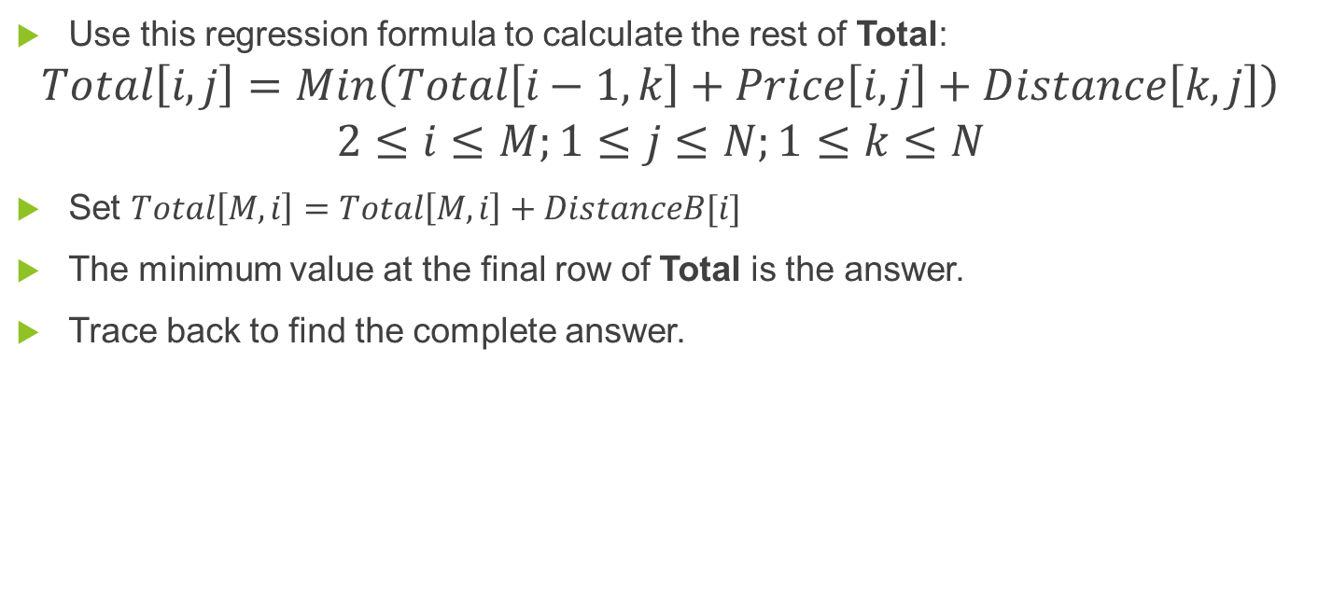
Solution
Use this regression formula to calculate the rest of Total:
$$Total\left[i,j\right]=Min\left(Total\left[i−1,k\right]+Price\left[i,j\right]+Distance\left[k,j\right]\right)$$
$$2≤i≤M;1≤j≤N;1≤k≤N$$
Set $Total\left[M,i\right]=Total\left[M,i\right]+DistanceB[i]$
The minimum value at the final row of Total is the answer.
Trace back to find the complete answer.

Slide 7
Example
X
4
7
5
8
A
B
7
6
2
5
Y
Z
3
DistanceA
4 | 5 | 7
Distance
 | 1 | 2 | 3
1 | 0 | 5 | 7
2 | 5 | 0 | 3
3 | 7 | 3 | 0
DistanceB
8 | 6 | 2

Slide 8
Example
X
4
7
5
8
A
B
7
6
2
5
Y
Z
3
Price | 1 | 2 | 3
1 | 8 | 7 | 10
2 | 12 | 5 | 4
3 | 9 | 7 | 6
4 | 11 | 15 | 17
5 | 20 | 18 | 18
Total
1
2
3
TraceY
1
2
3
1
12
12
17
1
-
-
-
2
24
17
19
2
1
2
2
3
31
24
25
3
2
2
3
4
40
39
42
4
2
2
3
5
60
57
60
5
1
2
2
68
63
62

Slide 9

Complexity
To traverse through all elements in Total array, we go through $M×N$ steps.
With each element, we traverse its previous row. Each row has $N$ elements.
In total, the complexity of this algorithm is $Ο\left(M×N×N\right).$

